Slide 1
Introduction to AI / ML and Deep Learning by using TensorFlow
11.02.2021

Slide 2
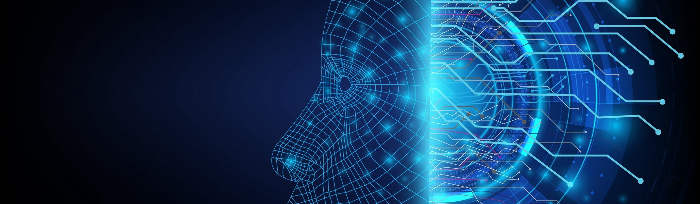
Introduction to AI / ML and Deep Learning by using TensorFlow
11.02.2021

Slide 3
Agenda
Intro of AI / ML and Deep Learning
Intro of Google Colab
Intro of TensorFlow 2.x
Practical
Convert Celsius Temp into Farhnite Temp
Image Classification with Fashion MNIST Dataset

Slide 4
Example of AI / ML
Recommendation engines
Google Search
Amazon Prime
Netflix
Self Driving Cars
Games
Chess
Ludo
Face Detection
https://builtin.com/artificial-intelligence/machine-learning-examples-applications

Slide 5
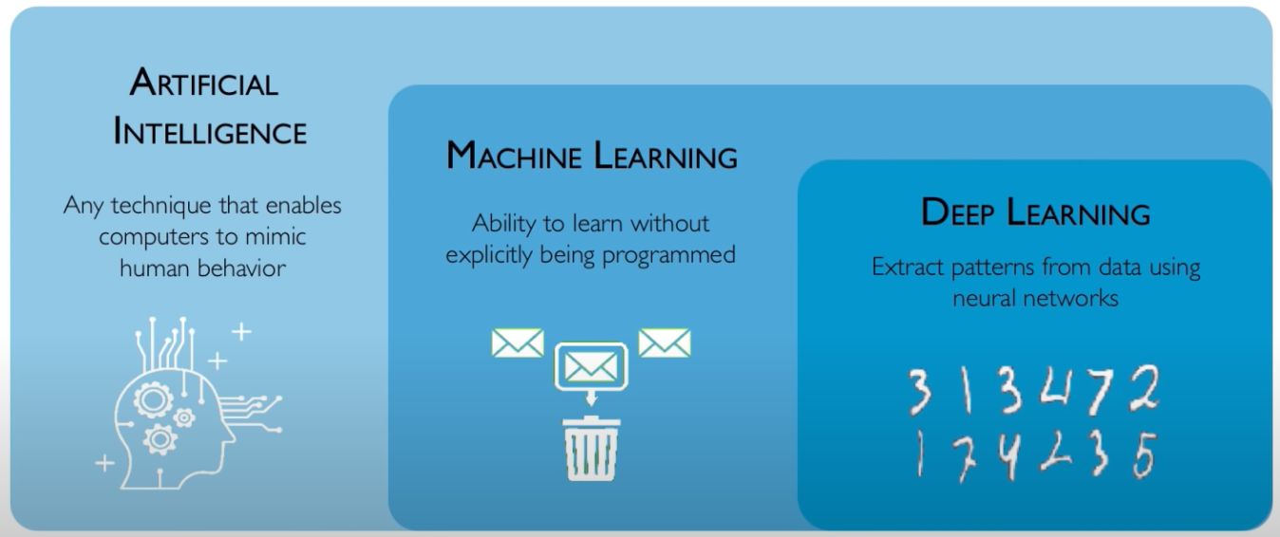
What is AI / ML and Deep Learning ?
https://www.youtube.com/watch?v=njKP3FqW3Sk&list=PLtBw6njQRU-rwp5__7C0oIVt26ZgjG9NI

Slide 6
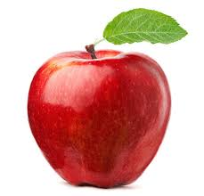
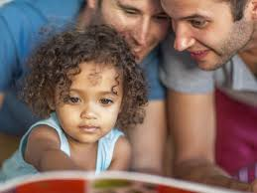
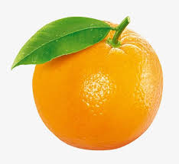
How Machine Learning Program works ?
https://www.youtube.com/watch?v=KNAWp2S3w94&feature=emb_logo

Slide 7
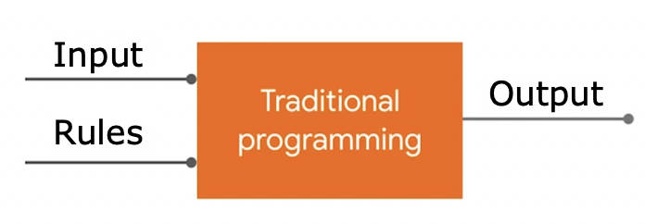
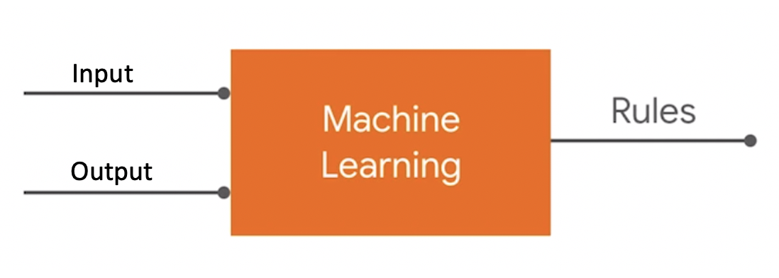
How Machine Learning Program works ?

Slide 8
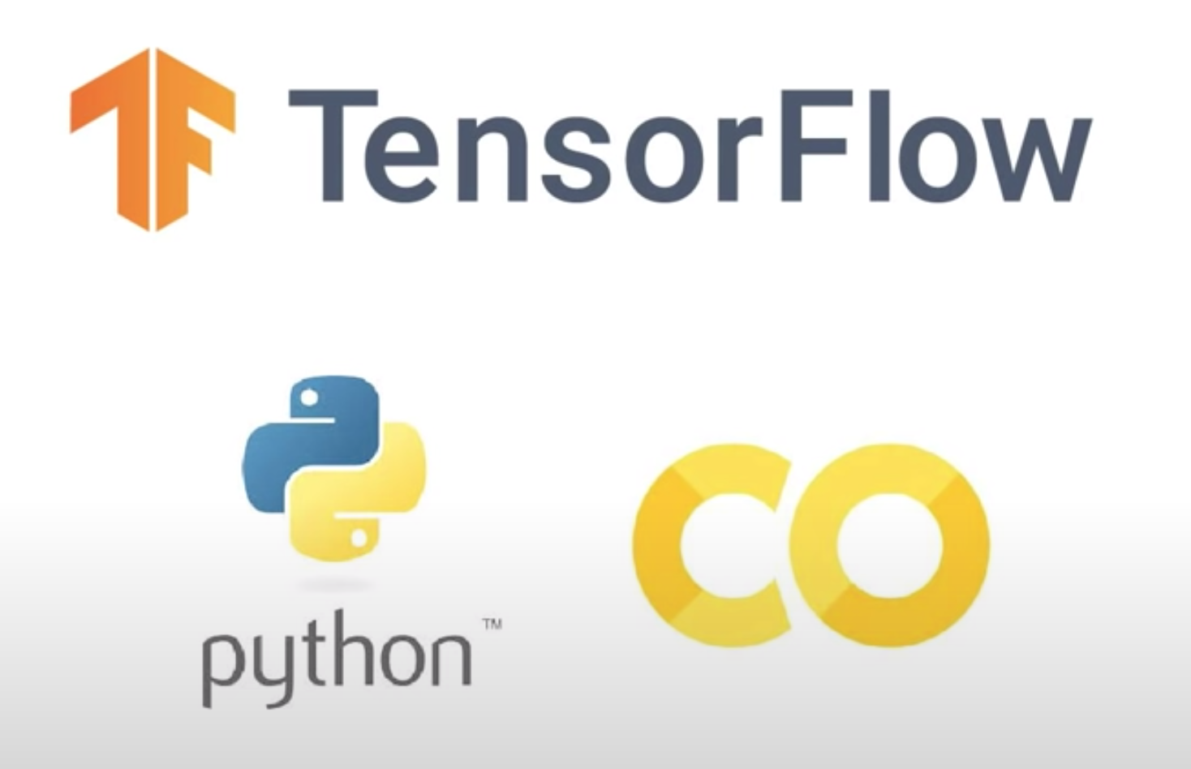

Slide 9


Slide 10
What is TensorFlow ?
TensorFlow is an end-to-end open source plateform for machine learning.

Slide 11
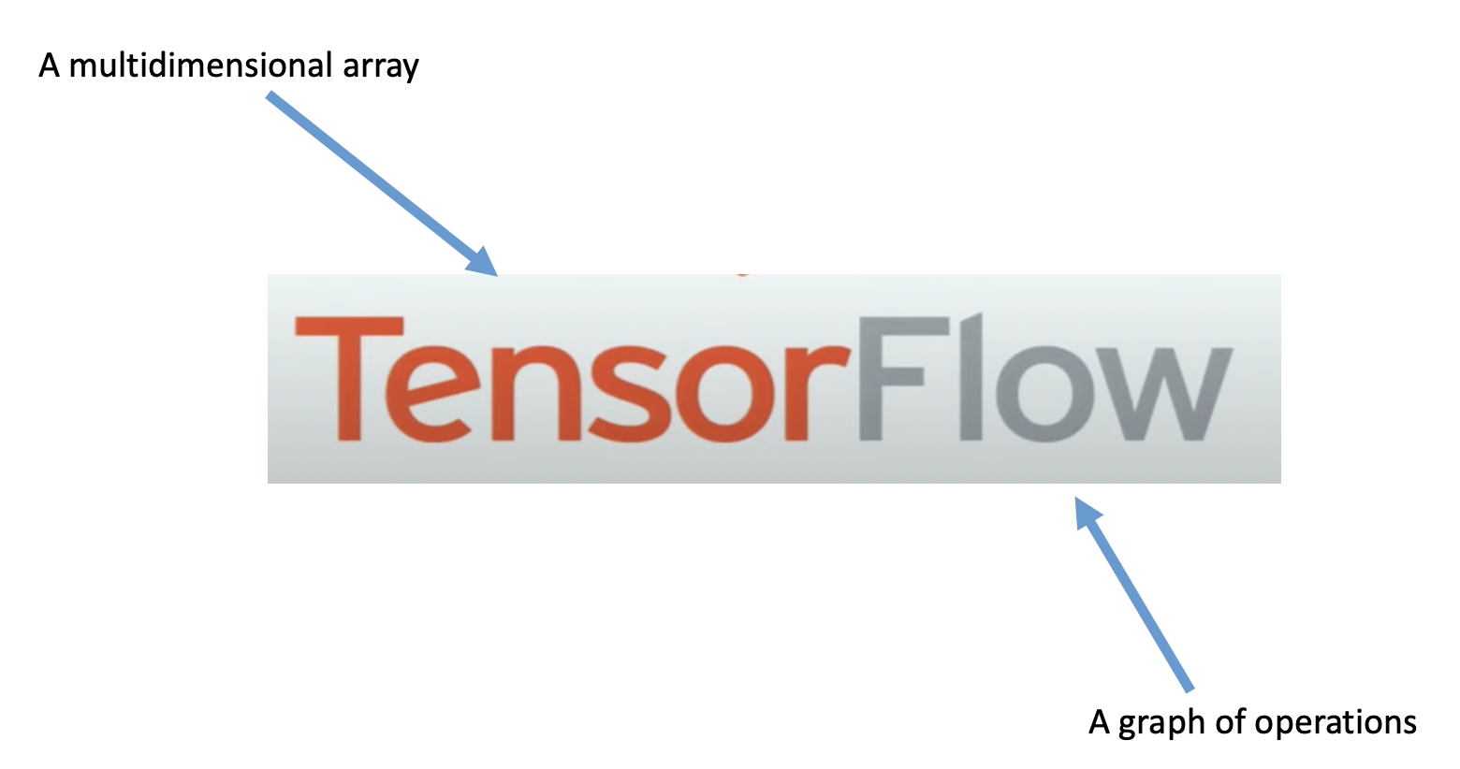
What is TensorFlow ?

Slide 12
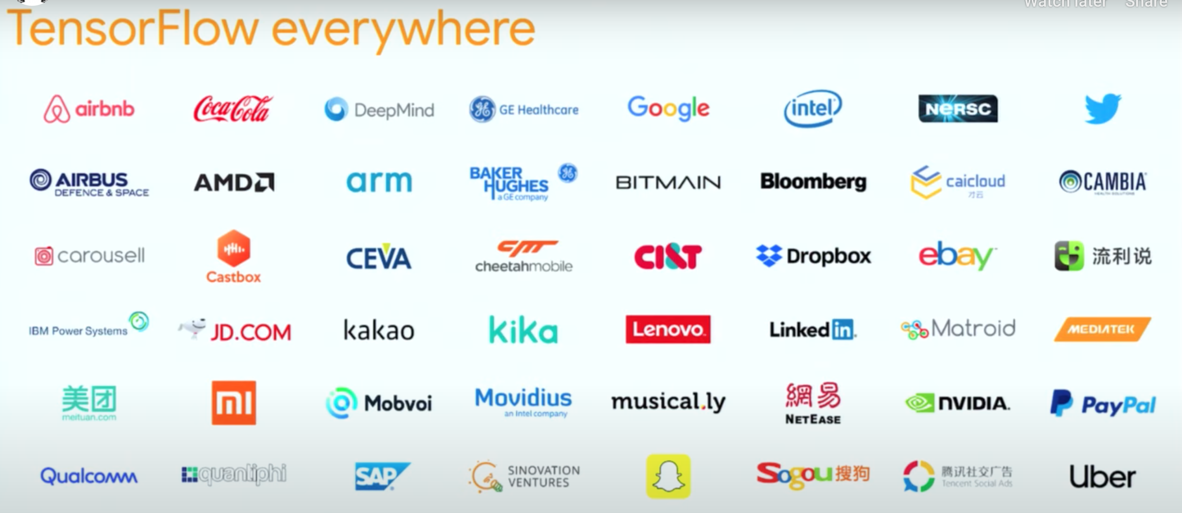

Slide 13
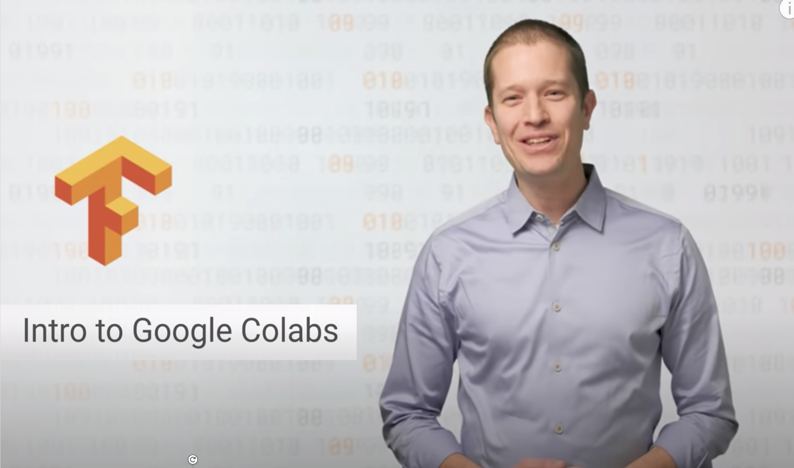

https://www.youtube.com/watch?v=inN8seMm7UI

Slide 14
Practical
Convert Celsius to Farhnite
Image Classification with Fashion MNIST dataset

Slide 15
Convert Celsius to Farhnite
Farhnite Temp = Celsius Temp * 9/5 + 32
Celsius Temp: 0 → Farhnite Temp: 32
Celsius Temp: 8 → Farhnite Temp: 46
Celsius Temp: -40, -10, 0, 8, 15, 22, 38
Farhnite Temp: -40, 14, 32, 46, 59, 72, 100

Slide 16
Convert Celsius to Farhnite
Celsius Temp: -40, -10, 0, 8, 15, 22, 38
Farhnite Temp = Celsius Temp * 9/5 + 32
Farhnite Temp: -40, 14, 32, 46, 59, 72, 100

Slide 17
Machine Learning Approach
Convert Celsius to Farhnite
Celsius Temp: -40, -10, 0, 8, 15, 22, 38
Farhnite Temp: -40, 14, 32, 46, 59, 72, 100
Farhnite Temp = Celsius Temp * 9/5 + 32

Slide 18
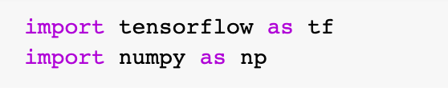
Machine Learning Approach
Convert Celsius to Farhnite
Import Required Library
Input & Output
https://github.com/DineshChopra/AI-ML/blob/master/TensorFlow/Udacity/1_CelsisusToFahrenheite.ipynb

Slide 19
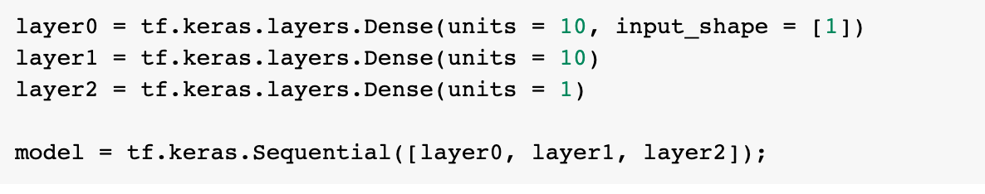
Machine Learning Approach
Convert Celsius to Farhnite
Create Model
Compile Model
https://github.com/DineshChopra/AI-ML/blob/master/TensorFlow/Udacity/1_CelsisusToFahrenheite.ipynb

Slide 20
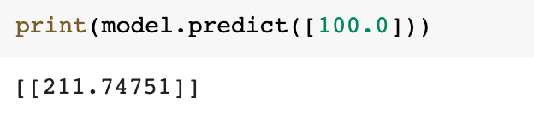
Machine Learning Approach
Convert Celsius to Farhnite
Train Model
Predict Model
https://github.com/DineshChopra/AI-ML/blob/master/TensorFlow/Udacity/1_CelsisusToFahrenheite.ipynb

Slide 21


Machine Learning Approach
Convert Celsius to Farhnite
https://github.com/DineshChopra/AI-ML/blob/master/TensorFlow/Udacity/1_CelsisusToFahrenheite.ipynb

Slide 22
Practical
Image Classification with Fashion MNIST Dataset

Slide 23
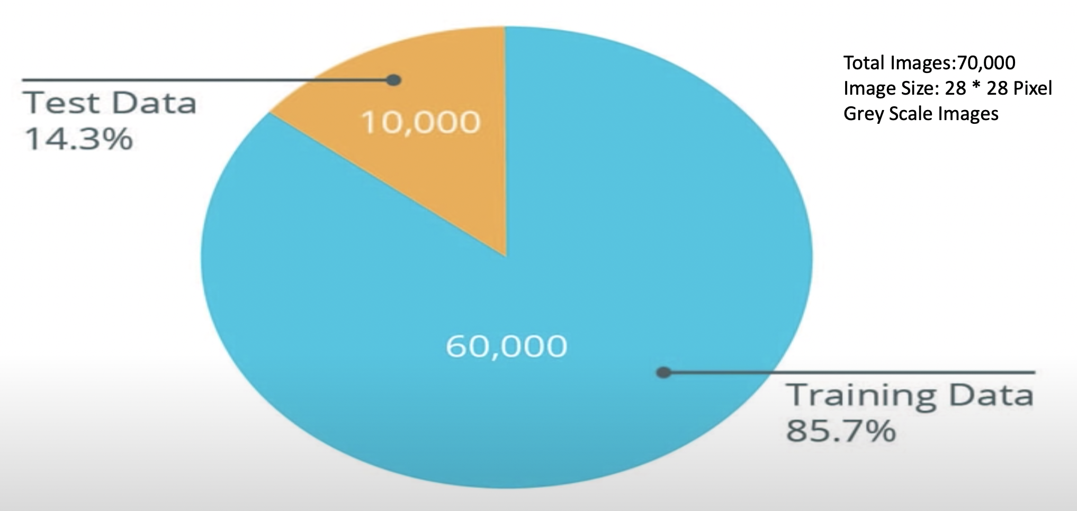
Image Classification with Fashion MNIST Dataset

Slide 24
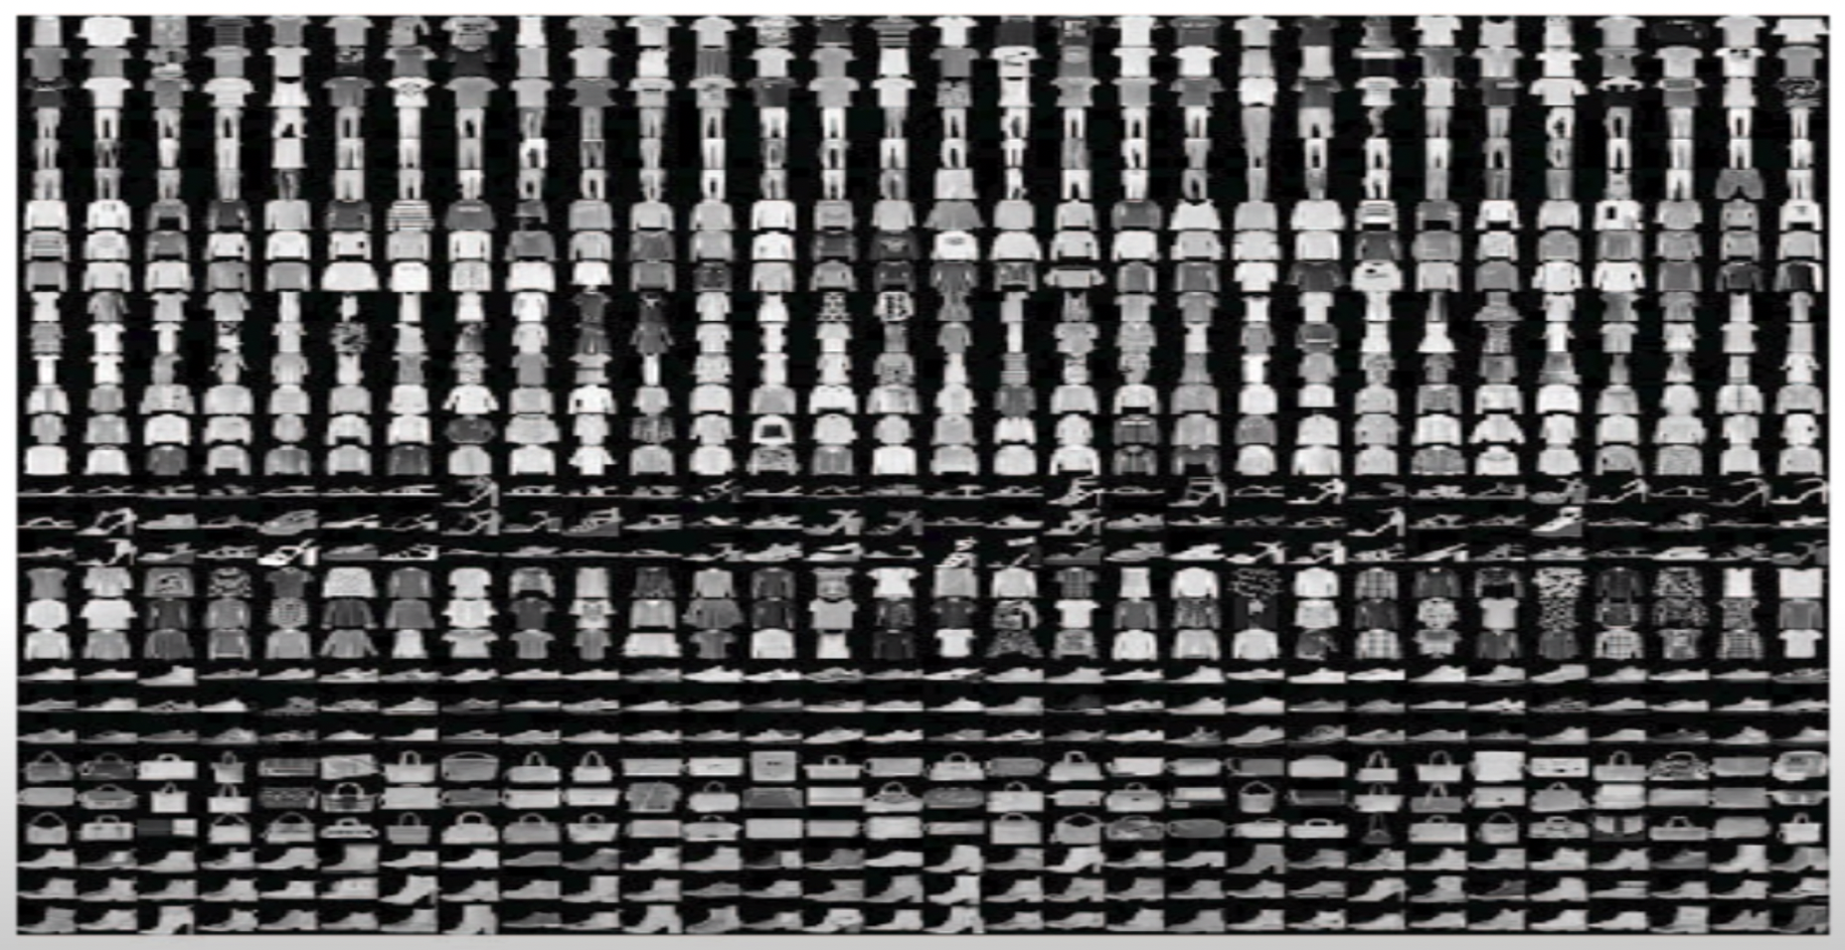

Image Classification with Fashion MNIST Dataset

Slide 25
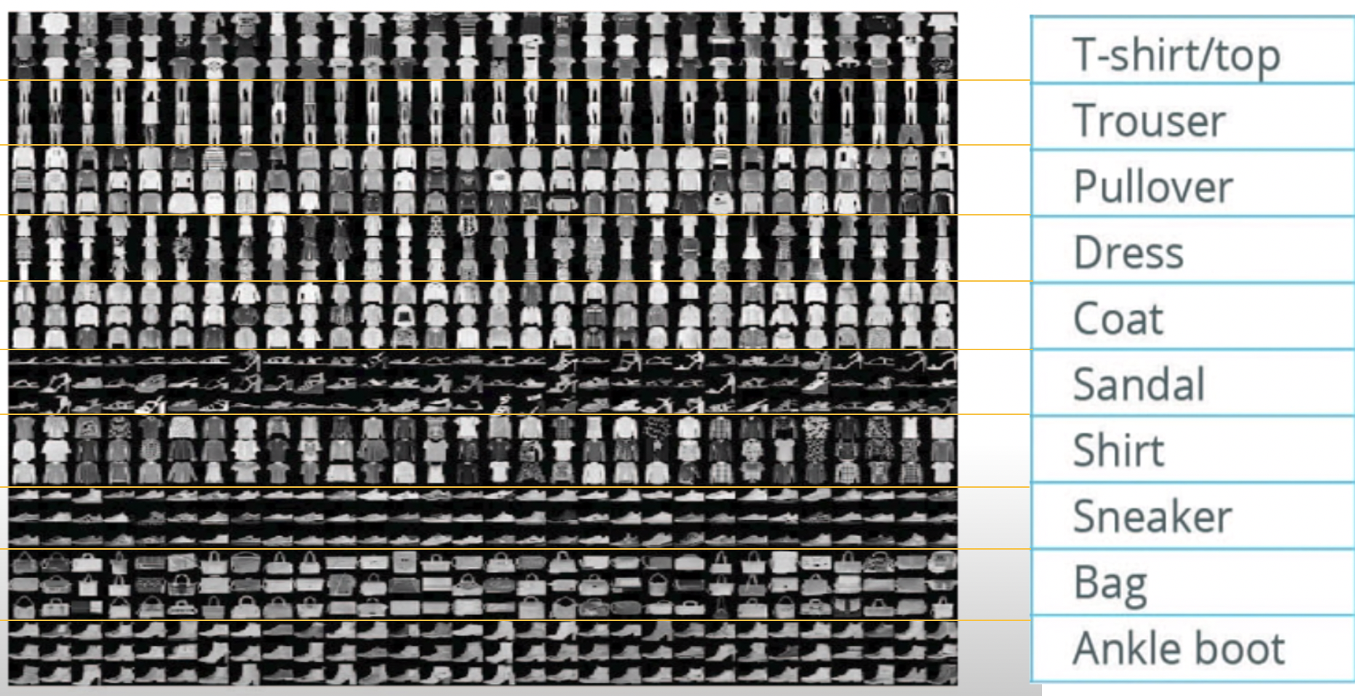
Image Classification with Fashion MNIST Dataset

Slide 26
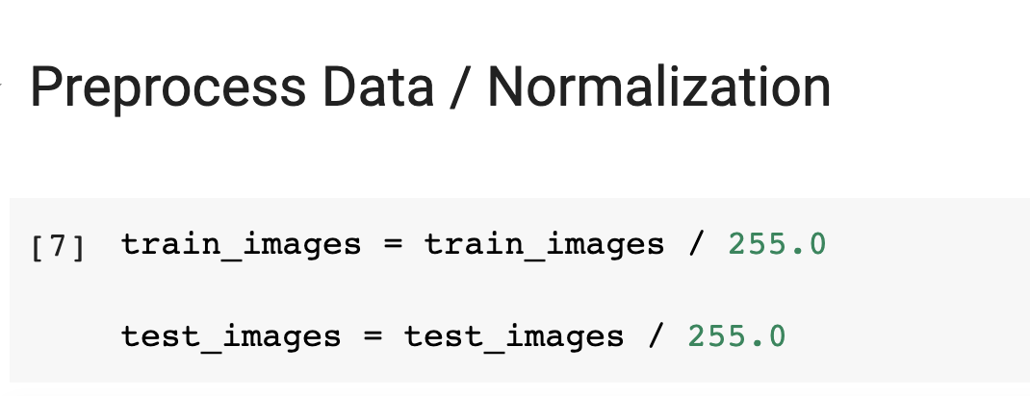
Image Classification with Fashion MNIST Dataset

Slide 27
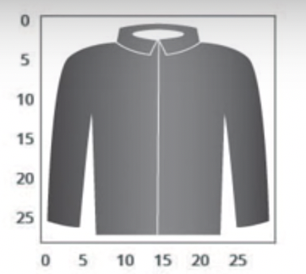
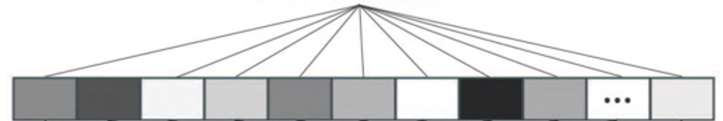
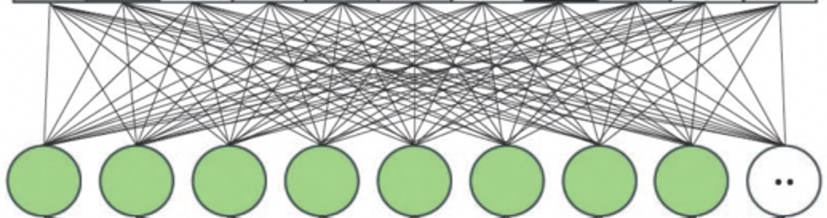
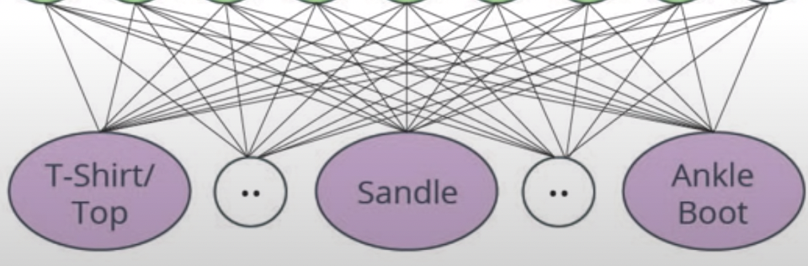
Image Classification with Fashion MNIST Dataset

Slide 28
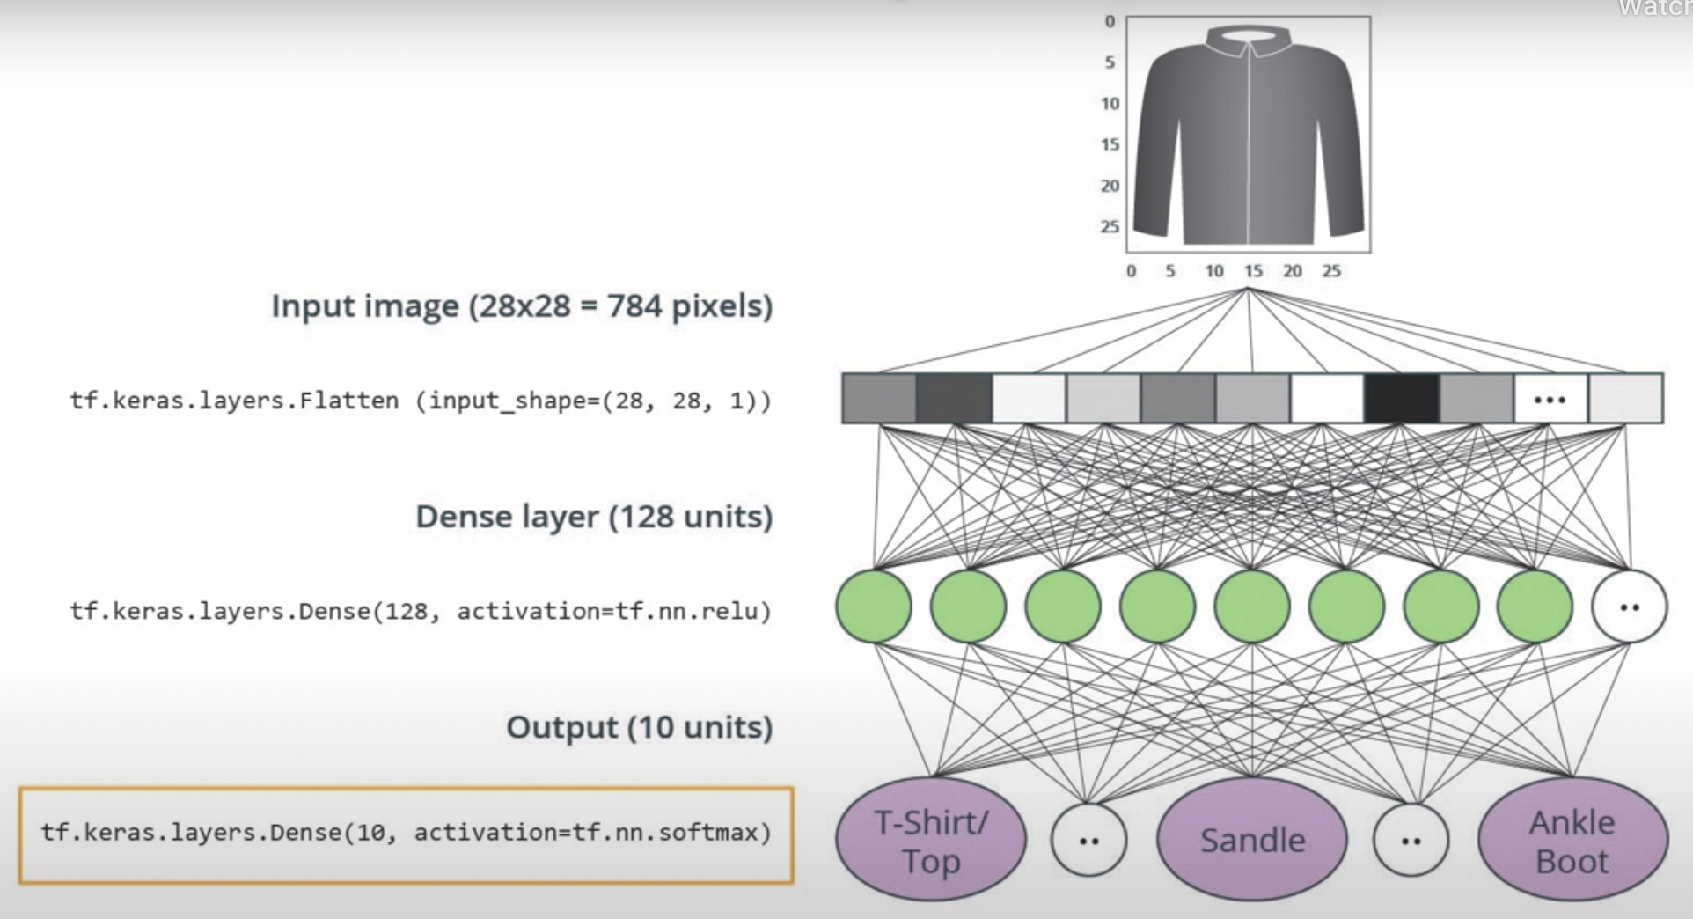
Image Classification with Fashion MNIST Dataset

Slide 29
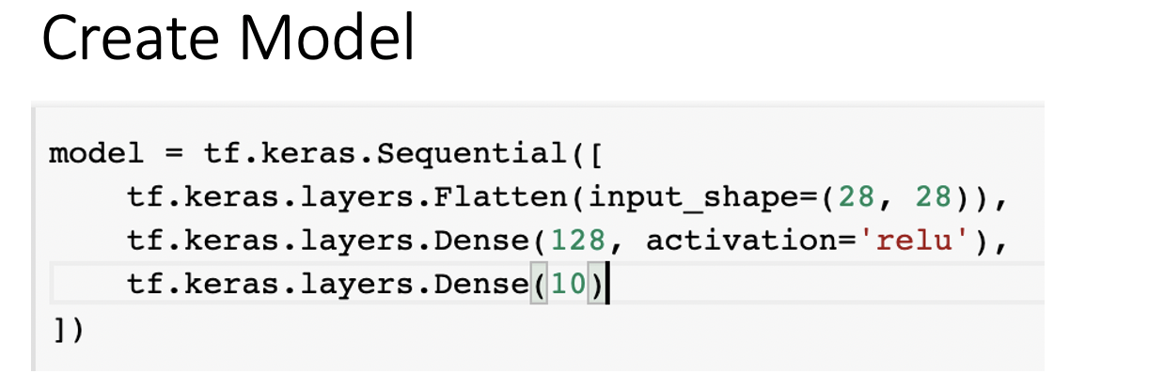
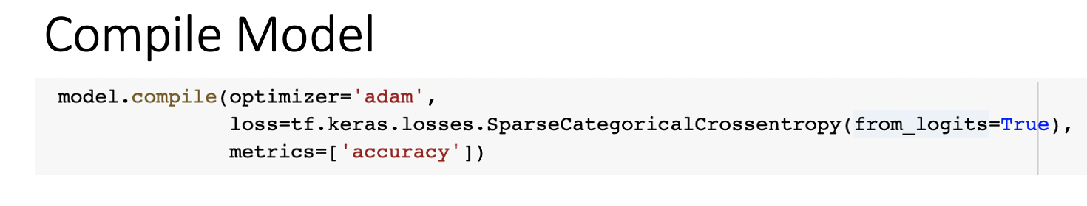
Image Classification with Fashion MNIST Dataset
https://github.com/DineshChopra/AI-ML/blob/master/TensorFlow/2_Fashion_Mnist.ipynb

Slide 30
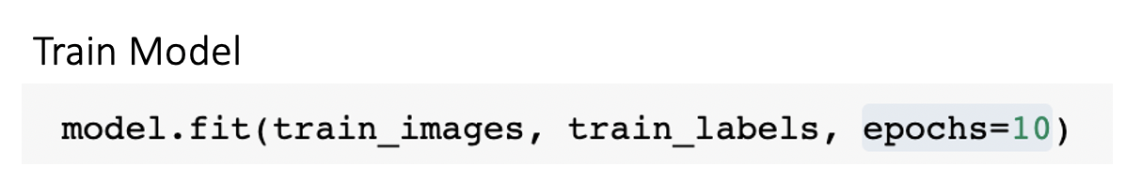
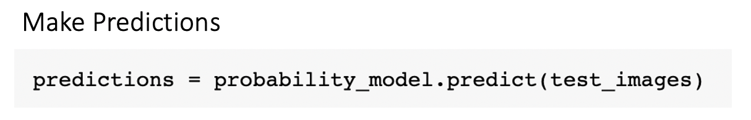
Image Classification with Fashion MNIST Dataset
https://github.com/DineshChopra/AI-ML/blob/master/TensorFlow/2_Fashion_Mnist.ipynb

Slide 31
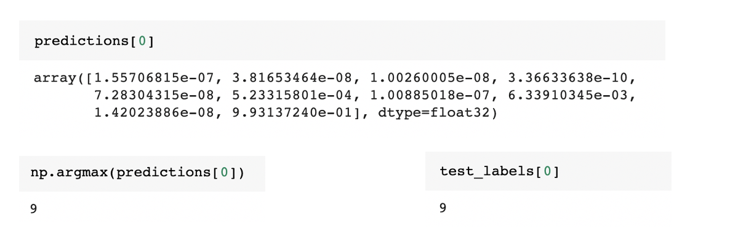
Image Classification with Fashion MNIST Dataset
https://github.com/DineshChopra/AI-ML/blob/master/TensorFlow/2_Fashion_Mnist.ipynb

Slide 32

Image Classification with Fashion MNIST Dataset
https://github.com/DineshChopra/AI-ML/blob/master/TensorFlow/2_Fashion_Mnist.ipynb

Slide 33
Summary
Intro of AI / ML and Deep Learning
Intro of Google Colab
Intro of TensorFlow 2.x
Practical
Convert Celsius Temp into Farhnite Temp
Image Classification with Fashion MNIST Dataset

Slide 34


Slide 35


Resources
Tutorial
https://www.tensorflow.org/tutorials/keras/classification
https://colab.research.google.com/github/tensorflow/docs/blob/master/site/en/tutorials/keras/classification.ipynb#scrollTo=9ODch-OFCaW4
https://www.udacity.com/course/intro-to-tensorflow-for-deep-learning--ud187
Free Course
How Neural Network Works ?
https://www.youtube.com/playlist?list=PLZHQObOWTQDNU6R1_67000Dx_ZCJB-3pi
MIT Introduction to Deep Learning | 6.S191
https://www.youtube.com/watch?v=njKP3FqW3Sk&list=PLtBw6njQRU-rwp5__7C0oIVt26ZgjG9NI

Slide 36


Slide 37
REVISION HISTORY
Rev No. | Date | Description of Change | Author | Review and Approved By
1.0 |  | Initial Draft | Dinesh Chopra | Tanmoy B (L&D)
2.0 |  |  | Dinesh Chopra

